Slide 1
Wipro Cyber Security and Risk Services
Enabling your transformation into a
cyber-resilient business
2024

Slide 2
Wipro CRS, What Makes us Different
Single Global Cyber Security Practice
Strongly Partners with the Broadest Set of Security Product Firms
Scale to Meet our Client’s Needs
Wipro Invests in Critical IP, Robust Platforms, and Emerging Businesses
Full Suite of Security Capabilities
Highly Flexible Onshore / Offshore Model
Notes:
Key Points of Presentation Today,
Full Suite of Security Capabilities: Wipro can support your security needs from the BOD to the Network. Having a complete set of security capabilities, a very deep bench of experts and thought leaders, and a diverse team capable of operating at all levels of the organization from policy, strategy, and risk issues down to hands-on expertise with intricate technical challenges.
Single Global Cyber Security Practice: Unlike the Big 4 and many of the other large consultancies that have a regional business structure and disjointed practices, Wipro has one global Security practice under a single leader. This allows Wipro to bring the best and brightest from around the world to solve our clients' problems. We naturally work as a global team for our global customers.
Highly Flexible Onshore / Offshore model: Wipro has resources situated globally around the world along coupled with expansive offshore capabilities allowing it to delivery our capabilities in the format this best fits our client’s needs.
Strong Alignment with the Broadest Set of Security Products Firms: Wipro has partnerships with over 70 technology vendors, giving us deep knowledge of the technology landscape, their strategies, and the role they play in solving our customer problems. These strong partnerships also allow us to price products highly competitive for our customers.
Scale to Meet our Customer’s Needs: With over 8000 CyberSecurest globally, over 20 Delivery centers, and 8 Cyber defense centers, Wipro can meet the demands of the largest and most complex customers.
Wipro Invests in Critical IP, Robust Platforms, and Emerging Businesses: Wipro does more then support our customers, we are constantly investing in solutions to problems our customers are facing. We both partner with our customers to build solutions to real-world problems, we also invest in emerging technology companies that are addressing critical needs of the marketplace.
Wipro is uniquely positioned to support our customers is the rapidly changing and increasingly complex security and risk market.

Slide 3
Wipro Understands the CISO’s Landscape
Challenges
Opportunities
Cyber Attacks
Enabling the Business
Ransomware, malware and supply chain malicious attacks continue to increase.
Ensuring security is enabling the business by enabling new business capabilities in a secure manner.
Social Engineering
New Transformative Models and Technologies
Social Engineering enhanced by AI is becoming more capable and dangerous.
Leveraging new transformative models such as Zero Trust to improve security and reducing exposure.
Data Sprawl
Reducing Complexity
Growth and proliferation due to the transient nature of data continues unabated.
Reducing complexity of your security capabilities is required to manage the natural tendency of security entropy.
Increasing Regulatory Complexity
Increasing Automation
Regulatory complexity and scope continues to increase.
Automation of security capabilities, controls and processes is required to make the best use of limited resources.
Growing Cost
Managing Costs
The cost to meet regulatory demands and secure the enterprise continues to rise.
Managing costs and becoming more efficient and effective with limited funds is critical to maintain appropriate levels of security.
Growth of AI
Growth of AI
AI is empowering threat actors, increasing the complexity in protecting data, driving new regulations and increasing the responsibilities of risk and security professionals.
Offers risk and security professionals enhanced tools to protect the organization, ability to improve automation of security processes, and enhance threat detection capabilities.
Notes:
Wipro Understands the Increasing Burden on CISO:
Some datapoints below that can be used in the discussion.
Cyber Attacks: “During the first quarter of 2024, organizations suffered 28% more cyberattacks on average compared to the previous quarter and 5% more compared to the same period last year.” (CyberNews 2024)
Social Engineering: Social Engineering Attacks saw a huge increase in 2023 and this trend is expected to increase. The increasing volume of social engineering attacks is matched by a broadening set of tactics and empowered by AI. (Cyber Threat Intelligence Report. 2024)
Data Sprawl: “by 2025, it is projected that 45% of global data requiring protection will be unprotected” - (2024 Thalas Global Data Threat Report)
Regulatory Complexity: National interests are leading to diverse requirements over information sovereignty, supply chain security, transparency of cyber controls compliance, incident reporting, and privacy. (2024 KPMG)
Growing Costs: Worldwide end-user spending on security and risk management is projected to total $215 billion in 2024, an increase of 14.3% from 2023. – (Forbes 2024 The Trends That Will Shape The Industry In The Coming Year)
Growth of AI: The staggering growth of AI is significantly increasing the risks, empowering threat actors, and expanding compliance requirements while also offering opportunities enhancing cybersecurity capabilities, Yet 34% of organizations do not have a Gen AI policy in place and 65% of respondents admit to not fully understanding the implications of Gen AI (State of Security 2024 report, Splunk)

Slide 4
Transformative Solutions Through
Comprehensive Capabilities
Our plan, build, run capabilities can help secure your organization more efficiently and effectively. Our global team of professionals can accelerate your success with leading solutions powered by:
Cyber
Defense
and Response
Cloud, Zero-Trust and Enterprise Security
Architecture
Risk and
Compliance Transformation
Core Advisory,
Emerging
Technologies
and AI
500+
Enterprise Clients Across the Globe
50+
Platforms, IP, Frameworks and Accelerators
Identity and Access Management
Application and
ERP Security
Data
Security and
Privacy
8
Cyber Defense Centers
8000+
CyberSecurists
Advisory and Strategy
Transformation and Implementation
Managed Services
Notes:
Key Points.
Wipro provides Strategy and Planning, Transformation and Deployment, and Manage and Run services across a comprehensive set of security capabilities. This allows Wipro to support our clients in addressing broad transformation challenges while also providing deep technical capabilities.
Wipro is a Long-Term strategic Partner to our Clients. From Advice around emerging technologies such as AI to supporting the transition to a cloud infrastructure to managing our clients Incident response capability.
Wipro’s Scale, Deep Expertise and Global Workforce can meet the needs of the Most Complex Global Customers. Wipro has a Global team of over 8000 Security professionals
Wipro’s flexible onshore/offshore Delivery Model provides allows us to meet the dynamic needs of or our most demanding customers.

Slide 5





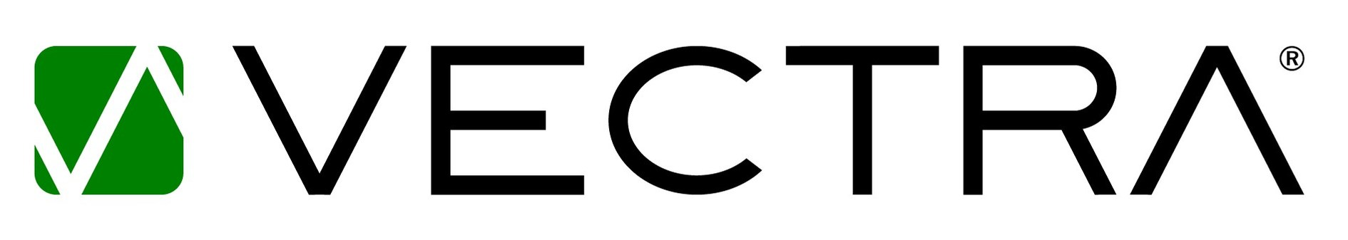



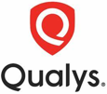



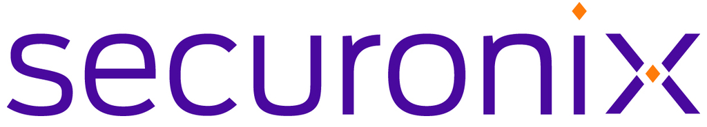


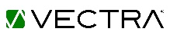

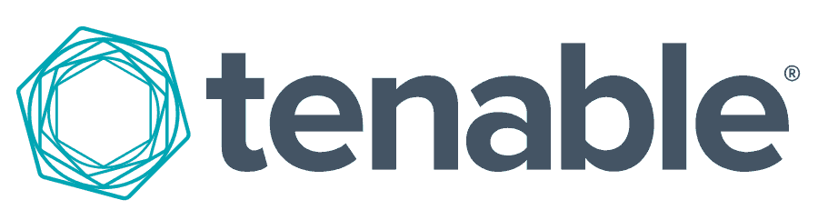
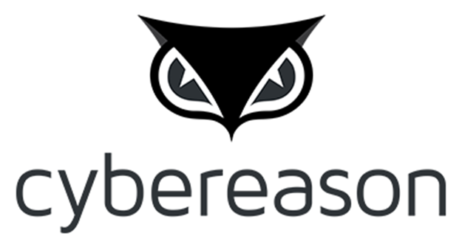

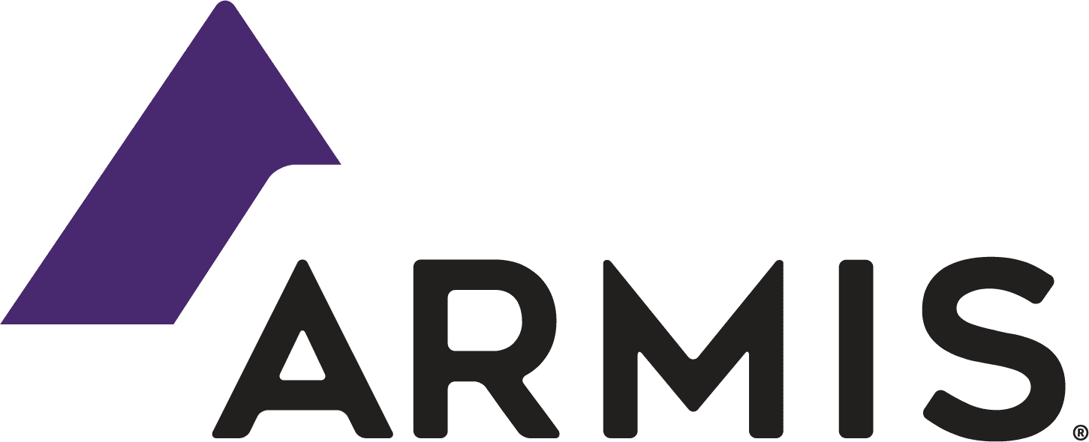






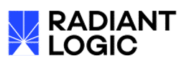



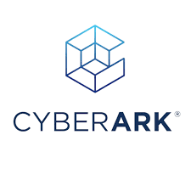

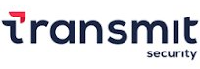

















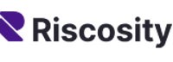
Wipro, Cornerstone of the Security Marketplace
5 Strategic Platform Partners
Vigorous partnerships with broadly capable security players with aligning visions from strategy to technology
30 Strategic Partners
Deep partnerships with major security firms ensures deep expertise and alignment on product roadmap
Cyber
Defense
and Response
Cloud, Zero-Trust and Enterprise Security
Architecture
Risk and
Compliance Transformation
Core Advisory,
Emerging
Technologies
and AI
6 Venture Partners
Wipro invests and partners with emerging technology companies that address critical needs in the security market
Identity and Access Management
Application and
ERP Security
Data
Security and
Privacy
38 Capability Partners
Build leading capabilities in the strategy, design and delivery of leading security product vendors
Advisory and Strategy
Transformation and Implementation
Managed Services
Notes:
Wipro has the most comprehensive partner network in the market today: This gives Wipro insight into helping clients choose the best solutions to meet their needs and provide the best support possible in their deployment and management .
Strategic Partners: Our Strategic Partners are where we have the deepest relationships, we engage in their product roadmap understanding and even influencing direction of products. These partnerships are backed up with the best internal thought leaders and skills.
Strategic Platform Partners: Our strategic platform partners provide a broad set of solutions across the multiple security realms. These platform solutions can help simplify your security environment through consolidation.
Emerging Partners: Wipro is actively working to address emerging security challenges through identifying companies addressing these issues and investing in those organizations and provide other support to ensure these critical capabilities reach the market
Capability Partners: Lastly Wipro has a number of partners where we maintain the highest level of capabilities. Although these partners are not strategic, their capabilities are critical to our customers and we bring the best and brightest talent.

Slide 6

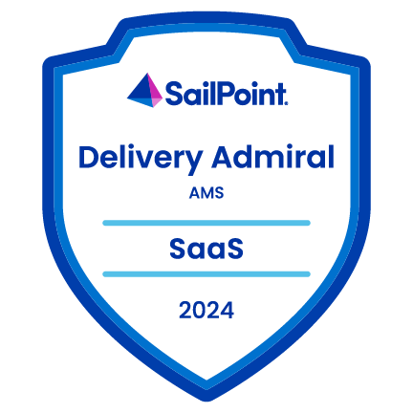
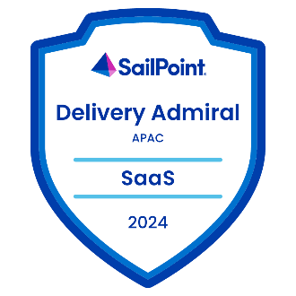

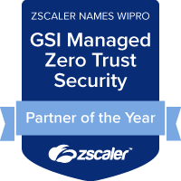

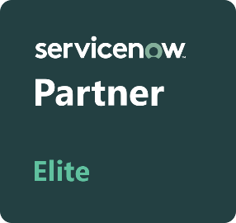


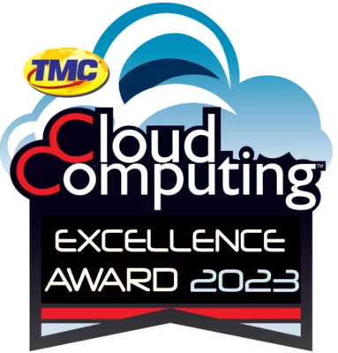

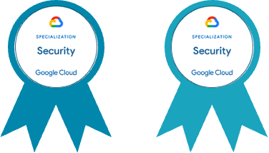
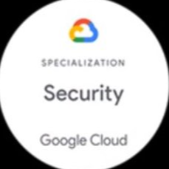
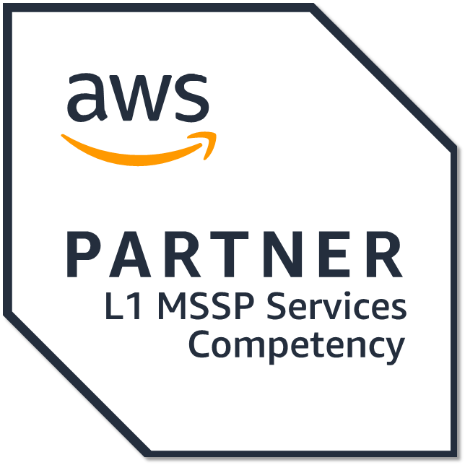
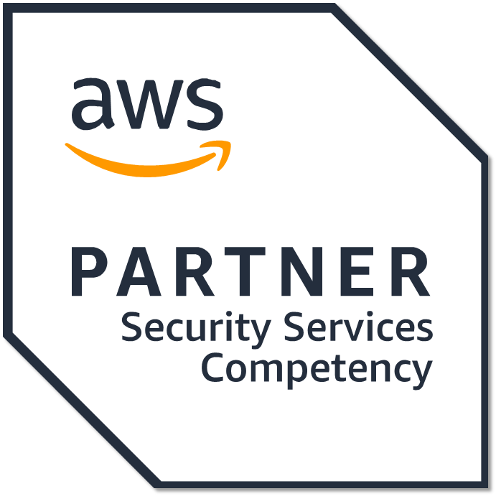
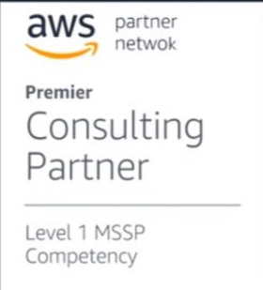

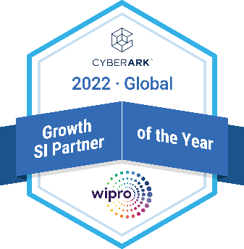





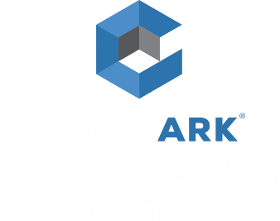

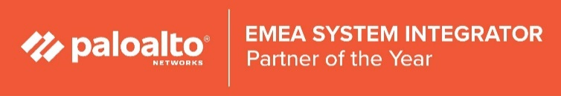
Wipro CRS, A Recognized Leader
Zscaler
Americas Partner of the year 2024
Netskope - GSI Growth Partner 2024
Cyble
GSI Partner of the Year 2024
Wipro’s CARG solution won TMC’s Cloud Computing Security Excellence Award for bringing innovations in area of Cloud Security - 2023
Wipro named a Leader in 2023 Gartner® Magic Quadrant™ for
Managed Network Services, Worldwide
AWS Level 1 MSSP Specialization Distinctions
Modern Compute Security
Managed Application Security Testing
Global – Security Specialization Partner
Global – Secure Application Development Partner
Global Innovator GSI Partner
1000+ Trained Professionals
Microsoft Advanced Specializations in Cloud, Identity, Threat and Data
#1 Global GSI for Defender for Endpoint and Microsoft Info Protection
Microsoft Intelligent SA Member
Wipro ranked as a Leader in Everest Group’s
Cloud Security Services PEAK Matrix® Assessment 2023
Wipro named a Leader in Everest Group’s Identity and Access Management (IAM) Services PEAK Matrix Assessment 2023
Notes:
These awards and recognition recognizes our leadership position in the market.
Some Highlights
Microsoft, We have won or ben a finalist as the top security partner on multiple years.
SailPoint, We have maintained our Global Admiral ranking as one of their top delivery partner for 8 years.
Everest Group: Repeatedly ranked us a leader in Cloud security services
Gartner: Ranked us as a leader in Managed network Services Worldwide
Cloud Computing: Cloud Computing Security Excellence Award.

Slide 7




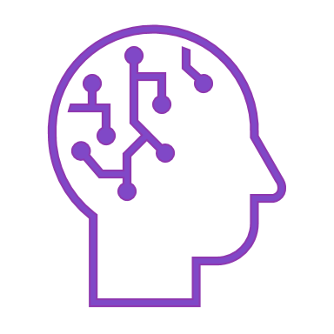
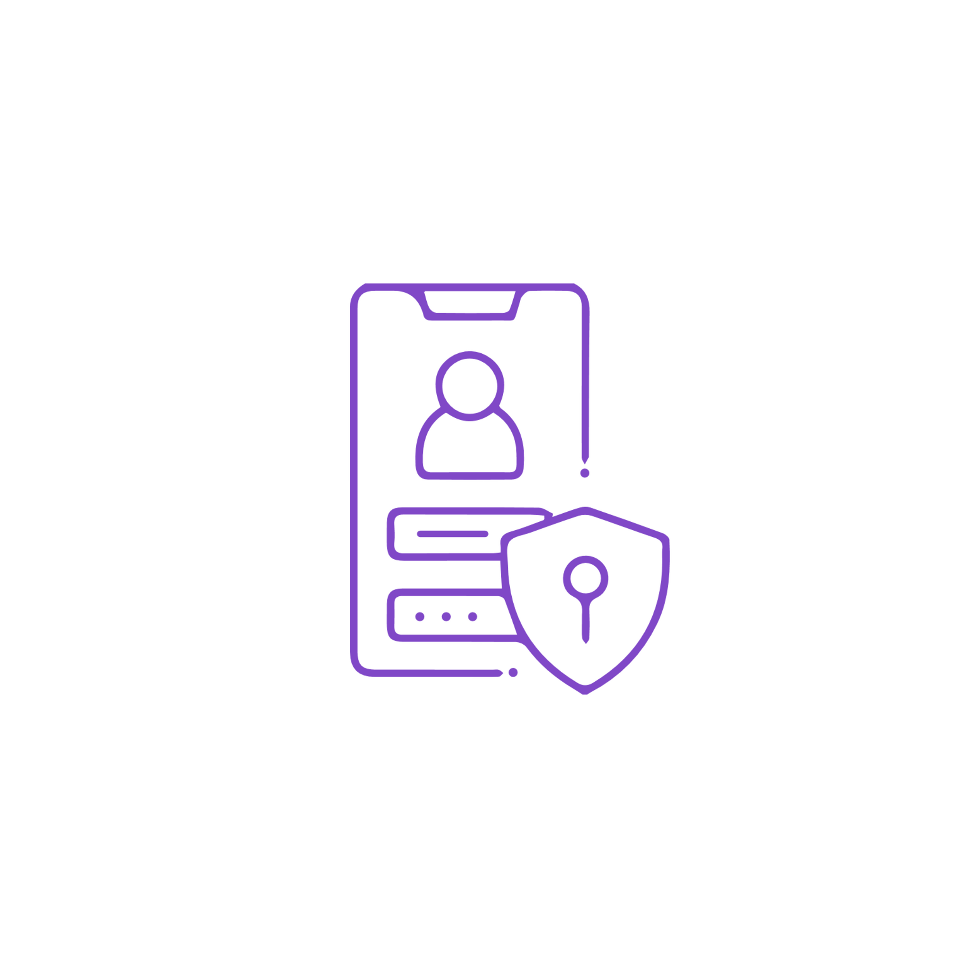

Continuous Investments in Security Solutions
8 Cyber Defence Centre CDC
Examples of Wipro Built Solutions
Intelligent Risk and Security
DeCentralized ID (DICE ID)
Achieve continuous monitoring, enhanced visibility and scalable security all streamlined for the modern enterprise.
Privacy preserving exchange
of digital credentials.
Dusseldorf, Germany
Reading, UK
Enterprise Data Obfuscation
Automated Regulatory Compliance (ArC)
Data masking platform that synthesizes irreversible data for use in non-production environments maintaining context, referential integrity.
Enables faster time to value through automated compliance tracking.
India 4 CDCs
Third Party Risk Management
Certificate Lifecycle Management (CLM)
Texas, US
Canberra, Australia
[Defence Level SECRET,
hosted and secured facility]
Automates the collection, validation and continuous monitoring of data.
Our solution to address the challenges of certificate mgmt. Its features cover certificate inventory management, provides automated expiry alert notification and escalation with a flexible policy framework, workflow definition and enforcement.
- Cyber Defence Centre
Cloud Applications Risk Governance
- Sovereign Cyber Defence Centre
Enables visibility into risk posture and governance of applications.
20+ Global Delivery Centres enable us to be ‘GloCal’
ISO 27001 certified, SOC 2 (generic/customer specific)
Identity Management Center
Provides a single view of the Identity and Access Management ecosystem.
Security Management Center
Identifies operational security risks across the business.
Notes:
Continuous Investment in Security and Risk Solutions: Wipro invests in with our partners and business partners is solutions that address critical needs in the marketplace. This concept of continuous investment focuses on providing value to our customers. Today, Wipro is making significant investments in areas like AI and Responsible AI.
Wipro has 8 Cyber Defense Centers: where it has critical resources working on solutions to critical problems.
Wipro also has 20 Global Delivery Centers: where the world where we have deep talent and capabilities.
Security Research and intelligence team: Constantly engaging with our customers, identifying critical ends, engaging in research and identifying critical problem and identifying solutions through partnerships, or development
Intellectual Capital and Solution: Over the years, Wipro has developed a wide range of solutions for our customers. This is an example of the kinds of solutions we are bringing to our customers to support them on their security journey.

Slide 8
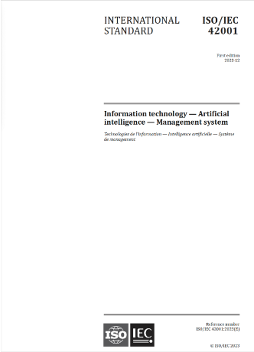
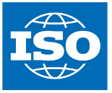
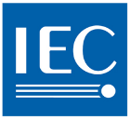

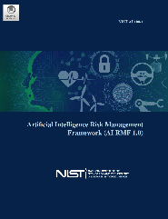
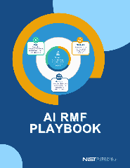
ArC - Automated Regulatory Compliance
Our ArC Content Service is maintained by compliance specialists in PCI DSS, Sarbanes Oxley, FFIEC, GLBA, FRB Reg A-YY, HIPAA, Privacy, FDA, NERC CIP and more.
ArC monitors federal regulatory amendments and state privacy laws, including state sources for personal information protection, security breaches, data sharing, identity theft, and notification.
+850 Authority Documents
+80,000 Citations
250 integrated Requirements
AI Source Highlights
ArC content is available for 20 industries through certified ServiceNow Store apps, and leverages a three-pronged compliance approach
          Updated Source Content Monitoring — provides industry-specific harmonized laws and regulations updated on a quarterly basis, as well as an accompanying summary e-newsletter.
          Source Change Notifications — provides update notifications for sources that are maintained and monitored by our ArC Content Team on a quarterly basis via a summary e-newsletter.
          Compliance Reporting — provides audience specific reporting on a mandate-by-mandate basis; present your risk and compliance posture in the language and format each regulator, examiner and auditor expects and requires.​
Industry Aligned
ISO/IEC 42001 Information Technology – Artificial intelligence – Management system
NIST Artificial Risk Management Framework (AI RMF 1.0)
NIST AI RMF Playbook
Notes:
ArC is one piece of our IP that demonstrates significant capabilities for risk and compliance by harmonizing over 850+ authoritative sources (think NIST, HIPAA, PCI DSS, DORA, etc.). ArC stands for Automated Regulatory Compliance and is delivered on the ServiceNow Platform in the IRM module.
Over 850+ Authority Documents representing regulatory agencies and standards bodies from around the world from HIPAA, NIST, FDIC, DORA, and the European Privacy Act.
The authoritative sources are parsed into individual, line-item citations (80,000+) that are verbatim from the source and are harmonized by our team to a very manageable 250 integrated requirements. The 250 integrated requirements tie 1:1 to 250 controls and 250 risks that allow our customers utilizing to apply a test/assess once, comply many approach.
On the ServiceNow Store, the ArC application is available for 20 industry specific packages or the Risk and Compliance team can support source selection workshops to pick which of the 850+ the client would like to ingest. Wipro updates ArC quarterly and sends digests to subscribers, so our customers are always up to date on their compliance requirements. For example, NIST CSF 2.0 recently was released and the ArC content was updated to include.
ArC-AI has been added to the content as different regulatory and standards bodies release requirements and frameworks.
Additionally, you will see the ArC library being leveraged in a wide range of our consultative services. Such as, but not limited to:
If Wipro designs an identity (or any other) solution for our customer, ArC will be leveraged to ensure the solution addresses the client's industry specific compliance requirements. For the identity example, ArC would have controls of the 250 related to access that tie back to the 850+ sources that are relevant to that customer. Drilling down further, ArC can help the customer see that PCI requires longer passwords than NIST when implementing a new solution.
Consulting/current state assessments – for example, if a customer asks for a current state assessment of their XYZ program in alignment with NIST, we can utilize ArC to differentiate how we will accomplish the assessment
ServiceNow IRM and beyond

Slide 9



Wipro’s Fields of Play Driving Strategic Results
CyberTransformSM
CyberShieldSM
CyberTransformSM
^{ENABLE BUSINESS GROWTH}
CyberShieldSM
^{DEFEND BUSINESS OPERATIONS}
Business-aligned,
strategy-first
cybersecurity
transformation
On-demand cyber
Resilience management
In an as-a-service
Model at scale
CyberTransformSM Field of Play solution components augment the three-pronged approach (Assessment, Strategy, and Transformation) through defined go-to-market offerings and solutions. These solutions are defined by our Consulting Packages, Quick Start Implementations and Platform IP related offerings.
CyberShieldSM Comprehensive cyber security managed services covering cloud, network, perimeter, endpoints, identity, data, OT and IoT, security monitoring, vulnerability and threat response using comprehensive technology management, Operational excellence, automation and AI.

Slide 10
Practice Area Overview

Slide 11




Core Advisory, Emerging
Technologies and AI
CRS Offerings
Differentiators
Cyber X-Ray
Quick Start Consulting Packages
          Executive/CISO Workshops
          AI Governance Workshops
Cyber
Defense
and Response
Cloud, Zero-Trust and Enterprise Security
Architecture
Risk and
Compliance Transformation
Core Advisory,
Emerging
Technologies
and AI
Identity and Access Management
Governance Solutions
and Target Operating
Models
Emerging
Technology and AI
Application and
ERP Security
Data
Security and
Privacy
Strategy and Roadmap
ARC-AI
Security Consolidation and Optimization Strategy
CISO Program Assessment (people, process, technology)
Responsible AI Governance Strategy
A Wipro Brand ServiceNow Store App with Expanded Use Case for Responsible AI
10+ Authoritative Sources with AI
Advisory and Strategy
Transformation and Implementation
NextGen Security Roadmap
12 | 24 | 36- month
Governance
Technology Enablement Roadmap
Emergent Technology (i.e. NextGen, Blockchain) infrastructure Strategy
Managed Services
Plan
NextGen Compliance Assessment and Roadmap
HIPAA | DORA | NIS2 | NIST
Software Supply Chain Assessment/Software Bill of Materials Practices
AI Controls and Framework Assessment
Stats
Enterprise Risk Management Program
ERM
Governance Documents
Policy | Standard | Procedure
AI Governance and Assurance
Build
Operational Risk Management Program
ORM
Organizational Program Remit and Charter
Refresh | Define
AI Risk Management Program
20+
Years Strategy and Risk Experience
10+
Industries with deep expertise
60+
Alliances and Partnerships
Information and Technology Risk Management Program
IT
Stakeholder Alignment and Governance Model
Refresh | Define
AI Compliance (Security and Privacy) Management Program
Wipro Contacts
Compliance Management Program
Refresh | Define
Metrics and Reporting
External | Internal
AI Software Supply Chain Security Risk Strategy and Roadmap
Peter Sweetland
Bala Bhaskar
Partner Solution Technologies
Notes:
Cloud:
Angshuman Chattopadhyay <angshuman.chattopadhyay1@wipro.com>
bhavesh Bhatt - cloud

Slide 12





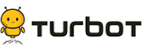



Cloud, Zero-Trust and Enterprise Security
Architecture
Differentiators
Full coverage – Strategy to Managed Services
Focus on strategic alignment within customers, grounded in business value and risk economics
Cloud Security Automation: 800+ Compliance as a Code (CaC), 250+ Policy as a Code (PaC), 65+ Security as a Code (SaC), 1200+ Cloud Control Checks
Different Wipro IP solutions to accelerate deployments and create better customer outcomes
Risk and Compliance aligned cloud modernization and workload protection
Key strategic partnerships and industry recognition
Cyber
Defense
and Response
Cloud, Zero-Trust and Enterprise Security
Architecture
Risk and
Compliance Transformation
Core Advisory,
Emerging
Technologies
and AI
Identity and Access Management
Core Enterprise Security
Modern Work Security
Application and
ERP Security
Data
Security and
Privacy
Enterprise SASE
Maturity Assessment and Roadmap
E5 Adoption Model
ZT Architecture and Strategy
Advisory and Strategy
Transformation and Implementation
Strategy and Cost Rationalization
Strategy and Cost Rationalization
Strategy and Cost Rationalization
Managed Services
Plan
Network Segmentation and Protection (NG Firewalls)
EDR and End Point/Server Security
Secure Web Access
Cloud Security Automation Factory (CSAF)
Network Control and Policy Enforcement
ZTNA and Secure Services Edge
Stats
Cloud Native Protection - CNAPP
M365 E5 Application Controls and Posture Management
WAF, DDoS, and App LBs
Build
250+
Enterprise Clients across the Globe
2500+
Cloud Cybersecurists
20+
Security Academies
Cloud Security Posture Treatment - CSPT
Secure Workforce and Collaboration
Critical Infrastructure Isolation and Threat Isolation
Next Gen MSSP
Desired State Configuration Monitoring
Next Gen MSSP
Wipro Contacts
Run
Cloud MSSP
Managed CNAPP
Angshuman Chattopadhyay
Bhaveshkumar Bhatt
Dean Fantham
Partner Solution Technologies
Cloud Application Risk Governance - CARG
JupiterOne
HashiCorp
Notes:
Cloud:
Angshuman Chattopadhyay <angshuman.chattopadhyay1@wipro.com>
bhavesh Bhatt - cloud

Slide 13






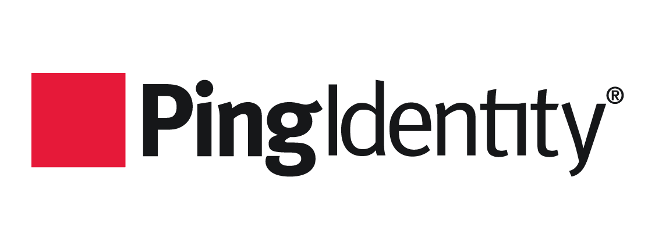




Identity and Access Management
CRS Offerings
Differentiators
Wipro’s Identity Management Center (IMC)
IAM as a Service offerings (IGA, AM, PAM, CIAM)
Wipro's ISTM (Identity Security Threat Management)
RBAC accelerator
Cyber
Defense
and Response
Cloud, Zero-Trust and Enterprise Security
Architecture
Risk and
Compliance Transformation
Core Advisory,
Emerging
Technologies
and AI
External Identities
Internal Identities
Identity Governance
Identity and Access Management
Wipro’s Identity Management Center (IMC)
Application onboarding accelerator
Centralized monitoring and dashboarding
Test automation
RPA-based automated provisioning
AI-based Identity automation
Application and
ERP Security
Data
Security and
Privacy
Customer Identity and Access Management (CIAM)
Capabilities Assessment
Identity and Access Management
Capabilities Assessment
Identity Governance and Administration (IGA)
Capabilities Assessment
Customer Identity and Access Management
Technology Enablement Roadmap
Identity and Access Management
Technology Enablement Roadmap
Identity Governance and Administration (IGA)
Technology Enablement Roadmap
Advisory and Strategy
Plan
Transformation and Implementation
Managed Services
Authentication and Authorization
| Multifactor Authentication MFA
Identity Life Cycle Management | Application Onboarding
Privileged Access Management Modernization | Cloud and Hybrid
Single Sign On | Password-less Authentication
Identity Provider IdP
Role-based Access Control
and Separation of Duties | PBAC
User Access Reviews
Stats
3200+
IAM CyberSecurists
385+
CRS IAM clients
across the Globe
100 Mn+
Identities Managed
Journey Orchestration | Progressive Profiling |Consent Management
IAM Modernization | Cloud and Hybrid
Identity of Things
Build
Dynamic Authorization | Identity Proofing | identity Fraud Management
Service Desk Integration | Access Request Portal
ZeroTrust IAM | JIT Access
3
Automation
Platforms and Accelerators
30+
Alliances and Partnerships
100K+
Applications and Systems Secured
CIAM Functional Program Support
IAM Functional Program Support
PAM and IGA Functional Program Support
CIAM Technical Solution Support
IAM Technical Solution Support
PAM and IGA Technical Solution Support
Wipro Contacts
Run
Brent Starns
Ashish Chandra
CustomerIAM Solution
Access Management as a Service
Identity Governance and Administration Solution
Partner Solution Technologies
CIAM as a Service
Identity Secure Threat Management
IGA as a Service
PAM as a Service
Notes:
Cloud:
Angshuman Chattopadhyay <angshuman.chattopadhyay1@wipro.com>
bhavesh Bhatt - cloud

Slide 14











Data Security and Privacy
CRS Offerings
Differentiators
Intelligent data command center – visibility of data
Discover your shadow AI and adopt AI securely
Reduce cost by identifying stale data in poly cloud
Peace of mind when processing and sharing data
Quantum readiness
Resiliency with our cyber vault solution
Cyber
Defense
and Response
Cloud, Zero-Trust and Enterprise Security
Architecture
Risk and
Compliance Transformation
Core Advisory,
Emerging
Technologies
and AI
Identity and Access Management
Data Classification
Data Protection
Privacy
Application and
ERP Security
Data
Security and
Privacy
Data Classification
Technology Enablement Roadmap
Data Protection
Technology Enablement Roadmap
Privacy
Technology Enablement Roadmap
Data Classification Program
Assessment | Refresh | Definition
Data Protection Program
Assessment | Refresh | Definition
Privacy Program
Assessment | Refresh | Definition
Advisory and Strategy
Transformation and Implementation
Plan
Managed Services
Data Discovery
Tokenization
Record Of Processing Activities
RoPA
Stats
Data Classification and
Enforcement
Public Key Infrastructure
PKI
Privacy Screening / Threshold Assessment
Data Governance and
Regulatory Compliance
Certificate And Key Management
Privacy Impact Assessments
Data Privacy Impact Assessments
PIA | DPIA
Build
Data Loss Prevention
and Insider Threat Protection
Digital Rights Management
Data Subject Management /
Data Subject Access Request
DSAR
120+
Global Customers
600+
Data Security
Associates
15+
Data Security Technologies
25+
OEM Partnerships
Data Classification
Functional Program Support
Data Protection
Functional Program Support
Privacy
Functional Program Support
Wipro Contacts
Data Classification
Technical Solution Support
Data Protection
Technical Solution Support
Privacy
Technical Solution Support
Jay Dial
Samrat Chaudhuri
Run
Partner Solution Technologies
Intelligent Data Command Center
Confidential Computing – Attestation Service
Data Security Posture Management
Notes:
Cloud:
Angshuman Chattopadhyay <angshuman.chattopadhyay1@wipro.com>
bhavesh Bhatt - cloud

Slide 15





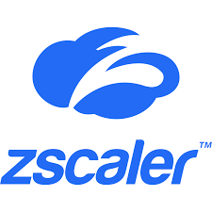

Application and
ERP Security
CRS Offerings
Differentiators
End-to-end cybersecurity solutions for SAP application landscape
Innovative technologies incorporating AI, automations, IPs, tools and accelerators
Tailored SAP cybersecurity solutions from assessment, advisory, transformations to managed services
Cyber
Defense
and Response
Cloud, Zero-Trust and Enterprise Security
Architecture
Risk and
Compliance Transformation
Core Advisory,
Emerging
Technologies
and AI
Identity and Access Management
Identity and Access
Governance for SAP
Enterprise Risk and
Compliance for SAP
Cybersecurity for SAP
Application and
ERP Security
Data
Security and
Privacy
End-to-End or Hybrid SAP Landscape Security Architecture Design
Security Health Check Assessment and Roadmap
SAP Security monitory and Auditing Capabilities Assessment
SAP Cybersecurity Product and Solution Recommendations and Roadmap Guidance
Identity and Access Governance Roadmap
SAP Security Performance Assessment
Advisory and Strategy
Transformation and Implementation
Plan
Managed Services
CIS Cloud Security for Public Cloud Provider Hardening for SAP Environment
SAP GRC Access Control, and Process Control,
Vulnerability Management
Stats
Access Design and Role Design / Redesign / Clean-Up for Business Process for P2P, R2R, H2H etc.
SAP Cloud IAS; IPS, IAG and SSO
Threat Detection
Build
Roles and Authorizations for SAP S/4HANA,
Integrated Risk Management for SAP through SAP GRC and Continuous Control Monitoring (CCM)
UI Data Masking and Data Security
400+
Enterprise Clients across the Globe
8+
Platforms, IP, Frameworks and Accelerators
500+
SAP Security and GRC Professionals
40+
Security Academies
25+
Years Experience
Roles and Authorizations for SAP Fiori and
SAP HANA Database
SAP GRC Risk and Audit Management
SAP-3rd Party Tool Integration
Onapsis
Identity and Password Management
SAP GRC Administration,
Support and Maintenance
Audit Reporting and Monitoring of ITGC Controls
Sarbanes Oxley | SoD
Wipro Contacts
Minor Enhancements, Application Development, and Application Delivery
Emergency Access Management |
User Recertification and Access Reviews
Service Request, Change Management, Incident Management and Problem Management
Utpal Malla
Allam Vinodh Kumar
Run
Partner Solution Technologies
Secure Digital Workplace
Enterprise SASE
Enterprise Protection
Notes:
Cloud:
Angshuman Chattopadhyay <angshuman.chattopadhyay1@wipro.com>
bhavesh Bhatt - cloud

Slide 16
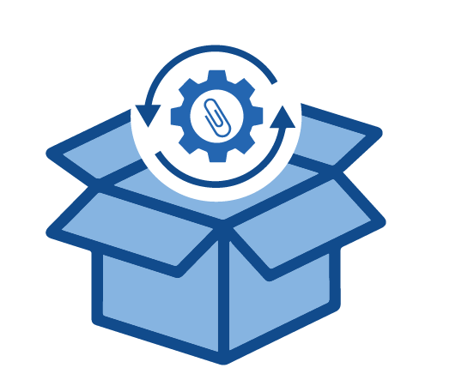


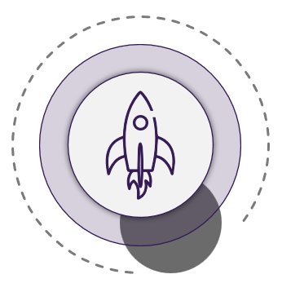



Risk and Compliance Transformation
CRS Offerings
Differentiators
Monitors global laws and regulations
over 850 authority documents
20 Industries
80,000 citations aligned to 250 integrated requirements
Cyber
Defense
and Response
Cloud, Zero-Trust and Enterprise Security
Architecture
Risk and
Compliance Transformation
Core Advisory,
Emerging
Technologies
and AI
Run with positive assurance to avoid audit fatigue
Gather and store evidence securely, enabling an, “assess once, test once, satisfy many” approach to compliance
Identity and Access Management
Evidence
Warehouse
Integrated Risk
Management (IRM)
Third-Party Risk
Management (TPRM)
Business Continuity
Management (BCM)
Application and
ERP Security
Data
Security and
Privacy
Plan and Build it Right the First Time
Scoring, ratings and tasking based on smart questions for consistent governance results
Compliance Technology Assessment
Third-Party Coverage
Assessment
Operational Resiliency
Readiness Assessment
Advisory and Strategy
Decision Engine
Transformation and Implementation
Risk Program
Assessment | Refresh | Definition
Third-Party Program
Assessment | Refresh | Definition
BC-DR Architecture
for Hybrid Cloud Assessment
Managed Services
Plan
Accelerating the implementation process
Solution relevant Quick Start decision tracker aligned to User Acceptance Test Plans and configurations for quick time to value
Policy Lifecycle and Exception Management
Business Engagement Intake Process
Business Impact Analysis
Quick Start Accelerators
Risk and Compliance Management
Inherent Risk and Tiering
Disaster Recovery
Stats
250+
ServiceNow
Certified SMEs
60+
Archer Certified SMEs
Build
Control Assurance and Continuous Monitoring
Vendor Corporate Security Program, Engagement Assessment and Continuous Monitoring
Business Continuity and Operational Resiliency
350+
ServiceNow Implementations
26
ServiceNow Certified Store Apps
10+
Quick Start Accelerators
Issues and Remediation
Issues and Remediation
Exercise and Crisis Management
Wipro Contacts
Risk and Compliance Functional Program Support
Third-Party Functional Program Support
BCM / DR Functional Program Support
Barb Johnson Hunter Freeman
Partner Solution Technologies
Run
Risk and Compliance Technical Solution Support
Third-Party Technical Solution Support
BCM / DR Technical Solution Support

Slide 17

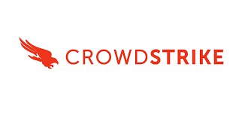






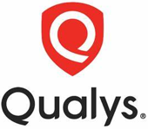
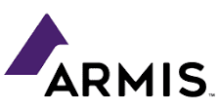





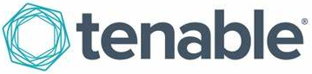








Cyber Defense and Response
CRS Offerings
Differentiators
80+ Accelerators includes scripts, playbooks and SOP
Exceptional service by monitoring and improving quality to increase efficiency
Provide high-quality results all the time for any application or infrastructure
CREST accredited organization for Penetration Testing
Leveraging AI to improve speed of scanning, Accuracy, resulting in less false positives
Collaborate: Orchestrate and streamline remediation intelligence across teams
Automated, structured and meaningful reporting to different stakeholders
Measurable and effective remediation actions to stay secure and complaint
Cyber
Defense
and Response
Cloud, Zero-Trust and Enterprise Security
Architecture
Risk and
Compliance Transformation
Core Advisory,
Emerging
Technologies
and AI
Operational Technology
Management
Identity and Access Management
Security Incident and Analytics
Attack Surface
Management
Application and
ERP Security
Data
Security and
Privacy
Security Incident and Analytics
Technology Enablement Roadmap
Attack Surface Management
Technology Enablement Roadmap
Operational Technology
Enablement Roadmap
Security Incident and Analytics
Consolidation and Optimization Strategy
Attack Surface Management
Consolidation and Optimization Strategy
OT Asset Management Strategy
Advisory and Strategy
Plan
Transformation and Implementation
Managed Services
Security Information and Event Management
SIEM
Vulnerability Scanning Management (Detection)
Application | Infrastructure | Container
SaaS Posture Management
OT Network Segmentation
Security Orchestration Automation and Response
SOAR
Vulnerability Management Workflows (Triage)
Application | Infrastructure | Container
External Attack Surface Monitoring
EASM
OT Secure
Remote Access
Stats
Build
Security Incident Case Management
Cloud Native Application Protection Platform
CNAPP
Case Management for Vulnerability Response Workflows
OT Asset Management
Discovery | CMDB
Threat Intelligence
Extended Detection and Response
XDR
Security Posture Control
(ASM Coverage)
OT Threat Monitoring
Detection | Triage
8
Cyber Defense Centers (CDCs) Globally
12
Cyber Defense Centers (CDCs) Globally
25%
Nearshore Coverage (US, UK, EU, APAC, MEA)
108+
80+
600+
AI for Security Workflows
OT Service Management
Incident | Change
Customers
Accelerators
Security
Professionals
Security Incident and Analytics
Functional Program Support
Functional Program Support
Penetration Testing
Functional Program Support
Vulnerability Management
Functional Program Support
Wipro Contacts
Jerald Carter Karthikeyan Veerappan
Run
Technical Solution Support
Technical Solution Support
Technical Solution Support
Partner Solution Technologies
Managed SOC
AI Powered DevSecOps
Penetration Testing and Red Teaming
Exposure Management

Slide 18
Next Steps

